Slide 1


Fast Revision + Survey 2015: v2c4, v1c8
BoP #; ECB
Gold Schemes
IMF Reforms
WTO Nairobi
Mauritius DTAA
E-Commerce
Resident yes, CGT..no
CGT applicable
Market Place
Inventory based
Yuan
Quota review
All Executive Dir. elected
Agri, cotton, SSM
ITA, L.D.C, evergreening

Slide 2


Theory +Economic Survey Vol.2 + Vol.1 + Budget 2016
1.Banking Finance
6.HRD
2.Budget-Fiscal Policy
3.BoP
4.Sectors of Economy
5.Infra
V2C2-Pub.Fin; V1C3-JAM
V2C3-Monetary mgmt+FI
V2C4-External sector
V2C5-Price,Agri.; V2C6,7
V2C8-Paris Summit, Energy
V2C9-Social infra.
V1C4-Agri ; V1C9-Fertilizer
V1C5-mother-child
V1C6-bounties; V1C7-Fiscal Cap
V1C8-PTA
V1C2-Chakravy; V1C10-Labour
V1C11-Powering 1 India
B1. Financial Sector Reforms
B2. Fiscal Discipline
B3. Tax Reforms; B4. Ease of
B5. Agro: 2x farmer income
B6. Rural infra-employment
B7. Infrastructure
B8. Social Sector & healthcare
B9. Education, Skills, Jobs
V2C1- Chakravyuh challenge
V1C1- Twin Balancesheet
IYB:7-Commerce

Slide 3
Agri. Science: NCERT
NCERT Class | Subject | Chapters
7 | Science | 3 & 9
8 | Geography | 4
 | Science | 1
9 | Science | 15
11 | Geography (India) | 6
12 | Geography (Human) | 5
 | Geography (India Land & People) | 5

Slide 4

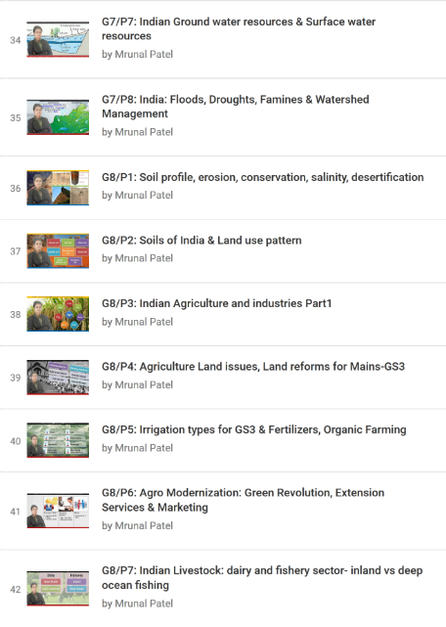
Self Study: Geography by Rajtanil► Indian Agriculture

Slide 5

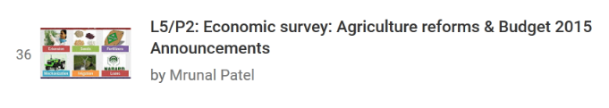
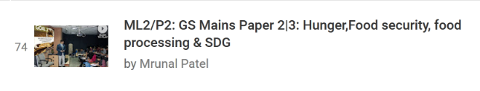

Self Study: Economy► Agriculture related Lectures
SDG targets imp for prelims
Notes:
SDG goals are relevent fort prelims.

Slide 6
Agri. Provisions
Krishi Kalyan Surcharge @7.5% on undisclosed income.
Krishi Kalyan Cess on services @0.5%
Food security => Income security 2x farm income by 2022 (@present median annual income <20k)
Budget 2016
Notes:
vol1-04-Agriculture_ More from Less
vol1-09-The Fertiliser Sector
vol2-05-Prices, Agriculture and Food Management

Slide 7
Statistics- ranking type MCQs
More than 50% nahi hai

Slide 8
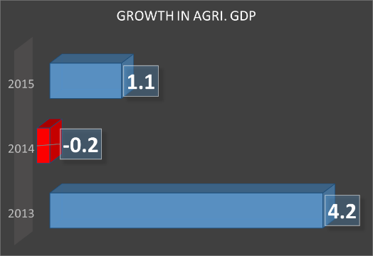
Growth in Agri-GDP compared to previous year
To double farm income by 2022,
Each year agri. Has to grow @14.86%!
To sustain 8% GDP growth rate, this must be 4%, said 12th FYP
Year | Crore Rs. (2011, constant price) | % change over last year
2015 (AE) | 16,02,036 | 1.1%
2014 | 15,84,293 | -0.2%
2013 | 15,88,237
60% agri=rainfall dependent
2 Drought years: 2014, 2015
Post-harvest loss, price volatility

Slide 9
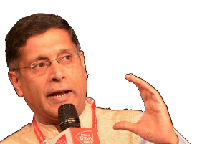

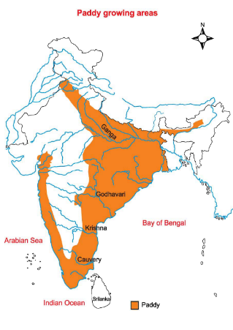
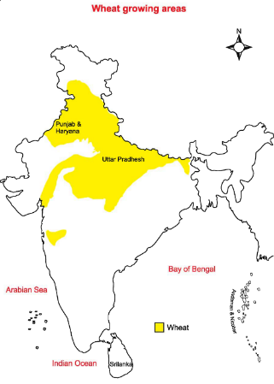
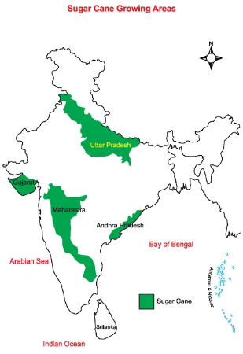
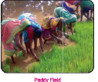

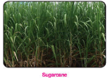
Indian agri. Input intensive: “land” + “Water”
SDG: to food security, price stabilization
Cereal Centric, regionally biased ..yes;
rotational cropping: no =soil fertility ▼
Input intensive
Rice per ht. yield
Punjab: 6000 kg
China: 6709
Input intensive “Land” ,
India’s best states << world avg.
India uses 2-4x more water than China, Brazil
Per ht.
46% less than China
Industrialization Area ∝1/under cultivation
Veggies, fruits, pulses shortage: inflation
Salinity, water table, drought
Notes:
What we got
cereal-centric
Rotational cropping…x…soil fertility ▼
regionally-biased
input-intensive (land, water, and fertiliser)
Yet remains
Pulses (protein)
Horticulture
China-Brazil produce more on less water (60%)
In marathwada for next five years, no new mills will be opened. Maharashtra counts for 32% sugar production in India.

Slide 10
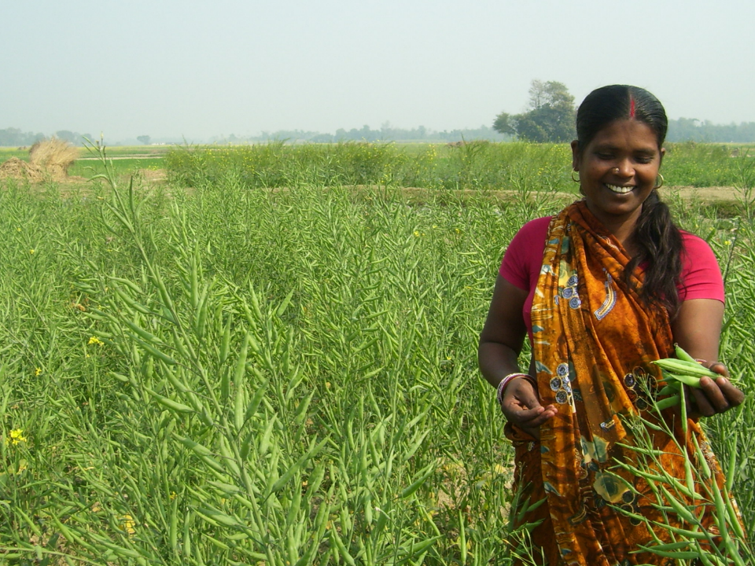
Pillar #4: Sectors of Economy ► Agriculture
Seeds, Irrigation, Fertilizer, Pesticides
Diversify
Credit, Insurance, Marketing
Husbandry
More from Less
$$
organic, pulses
Ranking
Budget’16

Slide 11
Wheat yield kg/ ht.
25% yield on seeds only
Green rev: only HYV of rice, wheat
Low RD, # of agri. Uni. Grads.
GM – address issues, but implement. Brazil, China also opening gates
Small farmers can’t afford, UP doing DBTA
Notes:
25% yield on seeds only
Green rev: HYV of rice, wheat; but not more R&D elsewhere
Low RD, # of students in agri. University;
Small farmers can’t afford, UP doing DBT
Government fixing max. sale price of cotton seed= but survey says price control bad idea- instead increase private participation
GM – address issues, but implement. Brazil, China also opening gates
Government fixing max. sale price of cotton seed= but survey opposed

Slide 12
R&D
national level competition among 674 Krishi Vigyan Kendras
a total prize money of Rs.50 lakh
Budget 2016

Slide 13
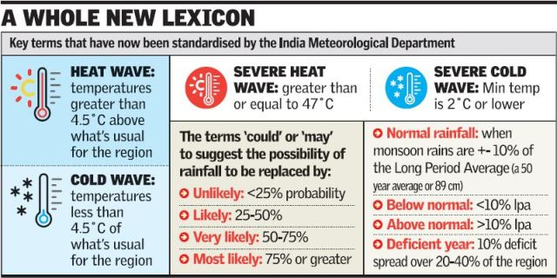

Drought declaration: States’ exclusive prerogative
Definition
Agri. Drought
Meteorological Drought
90% shortfall of avg. rain
If state’s 20%/> area affected.
Notes:
http://www.thehindu.com/news/national/no-more-droughts-in-india-says-imd/article8093638.ece

Slide 14
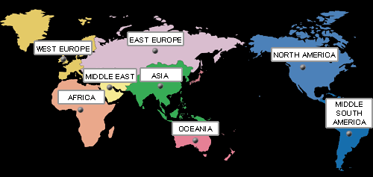
El-Nino and India
Drought
Kharif (Monsoon)
Prolonged Dry Winter
Rabi (Winter)
Since 1950, 22 El Nino. Strongest were
1997
1972
2009
1986
1987
El Nino- abnormal warming @Ecuador and Peru
More in This Article
Notes:
90% El Nino years= Below normal monsoon;

Slide 15

La-Nina = bumper crop, But survey passive
La-Nina: abnormal cooling of water along tropical west coast of S.Africa
Create buffer stock of essential commodities
Since 1950
Only 9 out of 21 El-Nino were followed by La-Nina.
This is 22nd El-Nino…

Slide 16
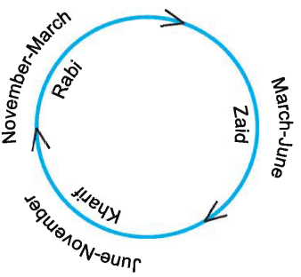
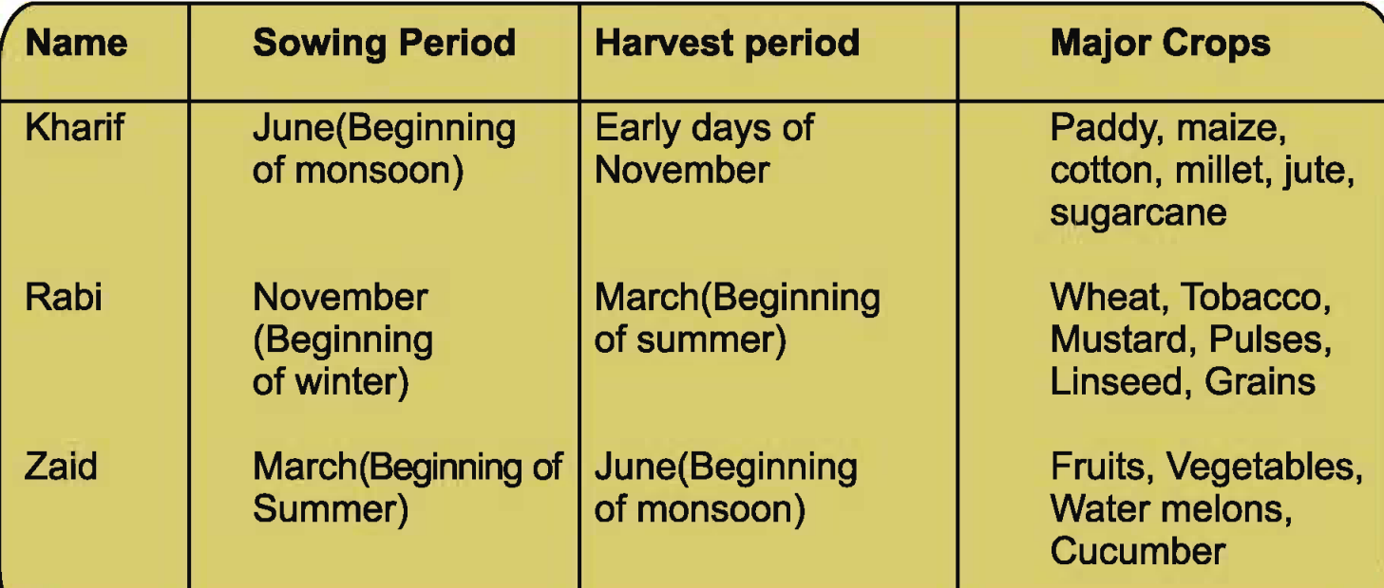

Slide 17
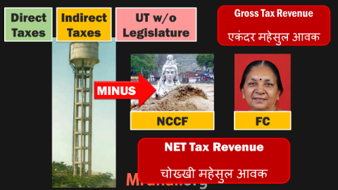
Gross vs Net Irrigated Area
Gross irrigated area
MINUS area irrigated multiple times
=NET irrigated area
Surface 25 mil.ht
Ground 40
Net 65 mil. ht

Slide 18
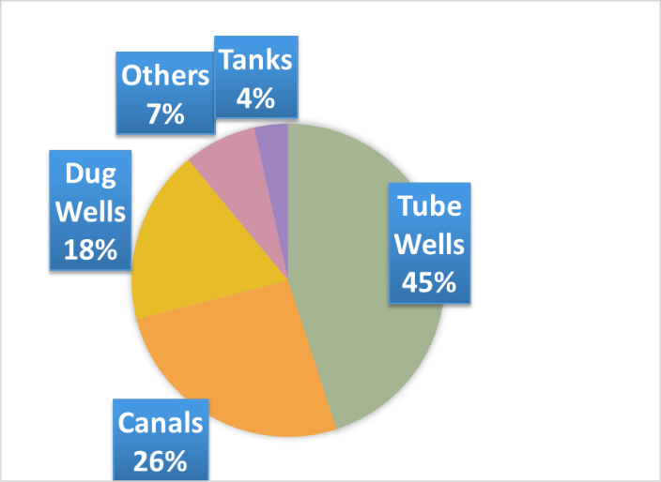
Sources of irrigation
For each kg of crop grown, we use 2-4x times more water than China/Brazil.
Water embedded in crop: India is net “exporter” of water through rice, cotton, sugar, soybean
Ranking for prelims

Slide 19
(Produce) More from less (Water, labour)
constrain
▲ Area under cultivation = x
Solution
Area under irrigation ▲
Use MNREGA labour for desilting tank, creating watershed etc.
▲ Water supply = x [60% monsoon]
▲ Labour = x [make in India]
Micro-Irrigation, Per drop More Crop
Mechanization ▲

Slide 20
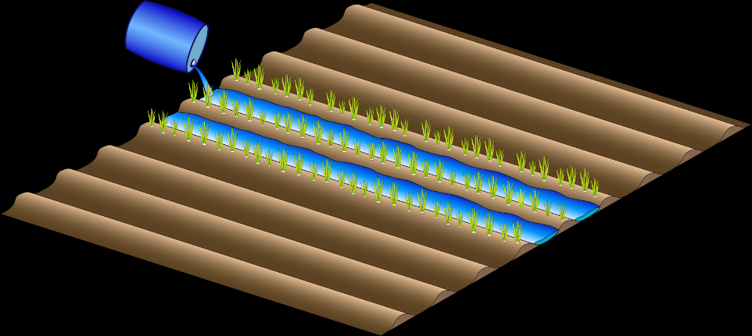
▲Area under irrigation but not via Flood irrigation because….
Private Borewell | Public Canal
Electricity/diesel =GHG
Little absorbed (38%) More evaporated Mostly wasted
Water table ▼ (0.3 mt. pa) | Soil Salinity ▲

Slide 21

STUPID MCQ
Find correct statement
Flood irrigation leads to water table decline by 0.3 meter per year
Only 38% of the water gets absorbed In floor irrigation.
Both correct
None Correct
UPSC doesn’t ask such trivial data. Don’t waste time in it, even if mock-test walla are doing

Slide 22
Micro Irrigation: examples, benefits
Drip irr.
Rain gun
Micro sprinklers
Fertigation: deliver (water soluble) fertilizer
Less Energy, labour, salination, water evaporation
Better yield: wheat 45%; soybean: 40%
High initial cost ☹ but energy savings, higher yield.
Farmers dislike micro-irrigation systems because nilgai, wild boar, monkeys etc. destroy them, and they get no compensation.
Notes:
Pipe maa jam thyi jaay

Slide 23
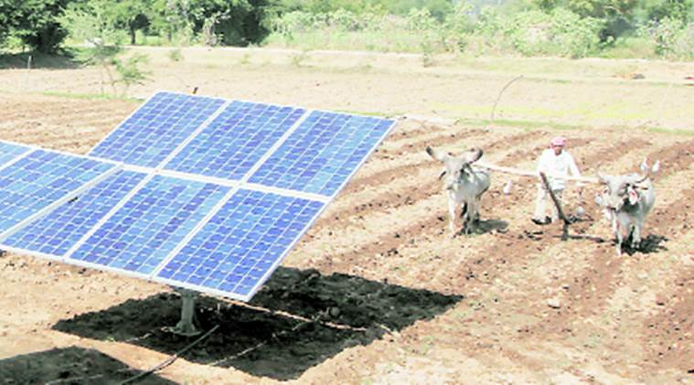
Solar cooperative “SPICE”: Dhundi village, Kheda
Subsidy to purchase
Under the shade,
spinach, carrots, garlic, beet and medicinal plants
Irrigation pump
No power fluctuation, GHG
Cooperative► Microgrid►
Excess electricity sold to Discom.

Slide 24
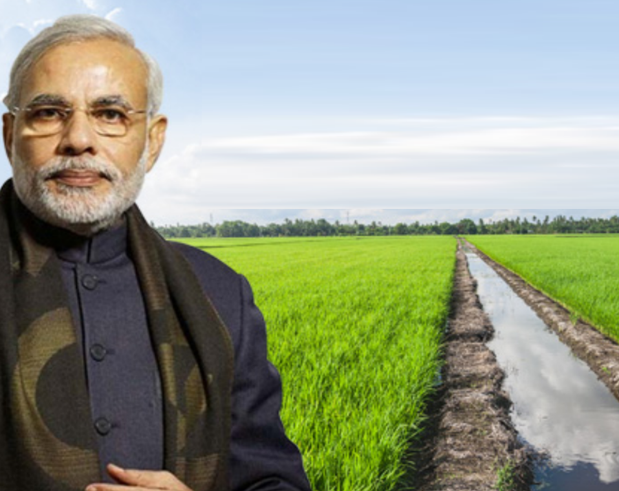
PM Krishi Sinchai Yojana
Har Khet ko Paani
▲ irrigated area
Per drop More Crop
Micro-irrigation
Jal Sanchay
Rain water harvesting; Conserve soil moisture, watershed; Ground water recharge; Muni-waste water►treat►agri.
Misc.
Info-Edu-Comm (IEC)
Private investments

Slide 25
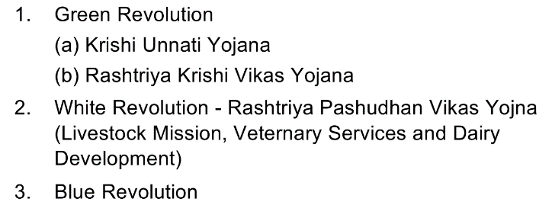
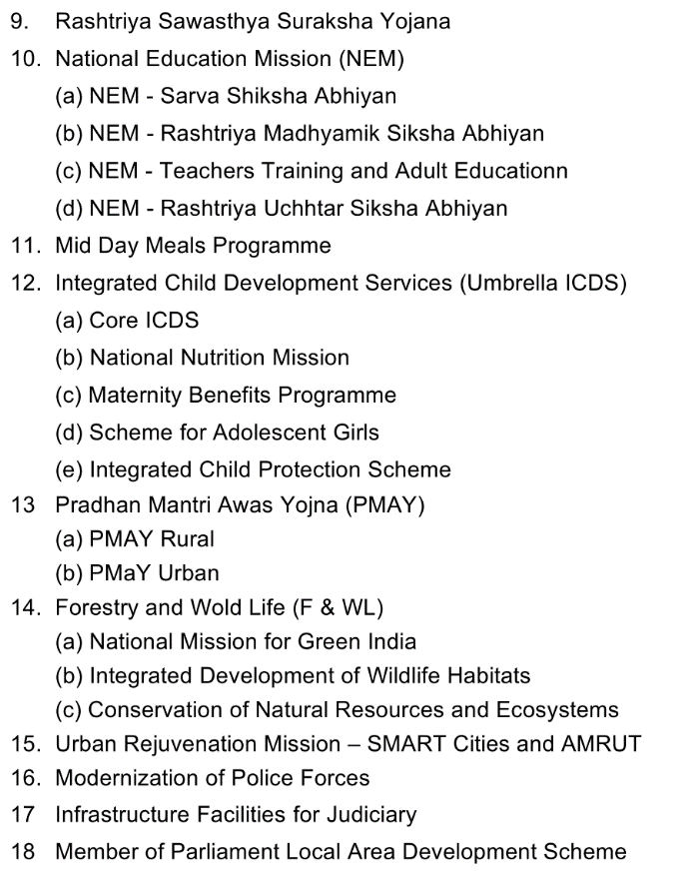
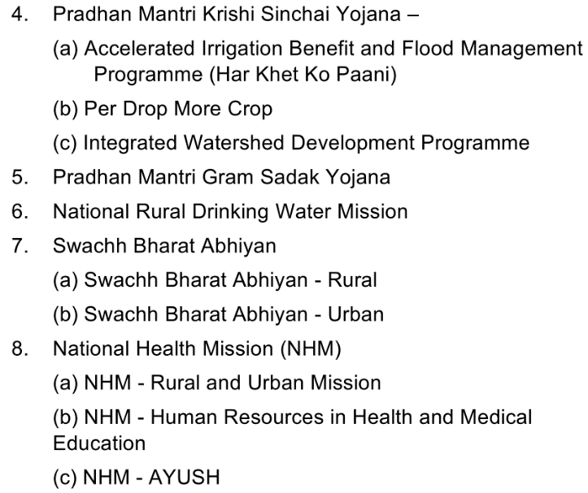

18 Core Schemes: 60-40 | 90-10
BES162/P-09
Notes:
Rashtriya Krishi Vikas Yojana is closed as per Wikipedia?

Slide 26

Funding & Convergence
PMKSY
MNREGA labour for de-silting water bodies, canals
MNREGA: labour: Material =60:40; but PMKSY fund can be used topup material cost.
MPLADS, JN-Solar Mission,
SCB► PSL fail► NABARD’s Rural Infra Development fund

Slide 27
PMKSY: accelerated implementation of all 3
Scheme
Major
Command area (ht)
Upto 2k
Minor
Medium
>2-10k
>10k

Slide 28
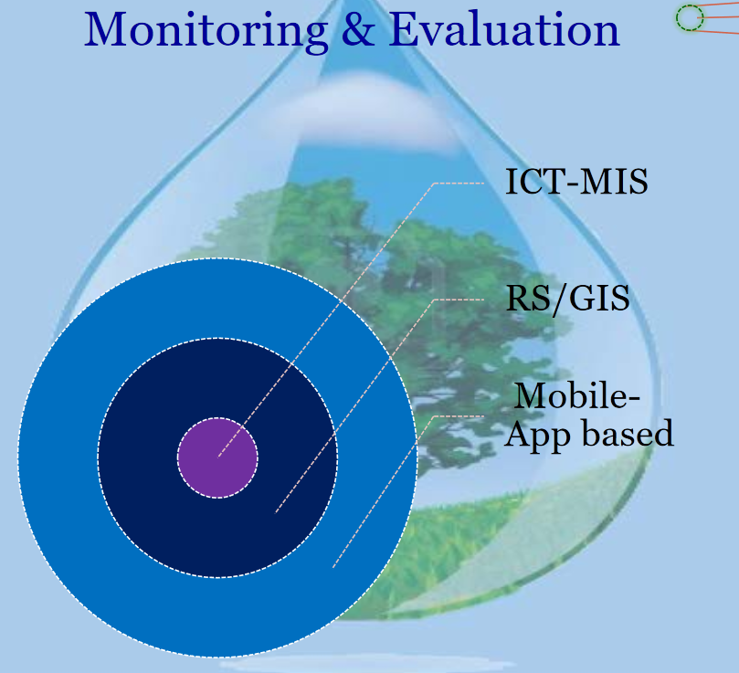
GSM3: E-Tech in aid of farmers: PM Krishi Sinchai Yojana
ML4/P1

Slide 29

Yearbook
___ ministry implements PM Krishi Sinchai Yojana?
Ministry of Agriculture & cooperatives
Min. Water Resources, River Dev. & Ganga Rejuvenation
Min. of Rural Dev., Panchayati Raj, Drinking Water & Sanitation
None of above

Slide 30
Irrigation
NABARD: Long Term Irrigation Fund-20,000 crore.
5 lakh farm ponds and dug wells in rain fed areas
Budget 2016
Notes:
vol1-04-Agriculture_ More from Less
vol1-09-The Fertiliser Sector
vol2-05-Prices, Agriculture and Food Management

Slide 31
Pillar #4: Sectors of Economy ► Agriculture
Seeds, Irrigation, Fertilizer, Pesticides
Diversify
Credit, Insurance, Marketing
Husbandry
More from Less
$$
organic, pulses

Slide 32




Urea subsidy leakage
Non-Agro; Cross-border (41%)
Rich farmers (24%)
Inefficient production (24%)
~35% reaches small farmers

Slide 33
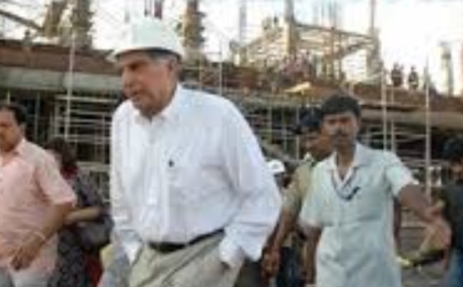

Cost-subsidy regime = Inefficient Production
Cost: +900/-
Subsidy – Rs.630
Fixed MRP Rs.270 /50kg
Cost: +1100/-
Subsidy – Rs.830
Fixed MRP Rs.270 /50kg
Chakravyuh: No incentive to improve technology.
Should be allowed to “EXIT”
Energy>> Labour intensive, not much problem unlike Aviation, Banks
Notes:
Cost plus subsidy regime
30 desi Company given Subsidy on production cost vs. Government fixed MRP.
Higher production cost = more subsidy = no incentive to improve technology.
Production cap. Not increasing, have to import.
Soln: NBS ambit, and allow exit.
Unlike bank, civil aviation – exit should be easier because less employed, more reliance on energy.

Slide 34

Leakage #2A: Cross border smuggling
61% UP farmers have to buy from Black market
Notes:
67% of UP farmers have to buy black market. (diversion to Nepal)
51% eligible farmers buy from black market.
Small marginal farmers suffer.

Slide 35
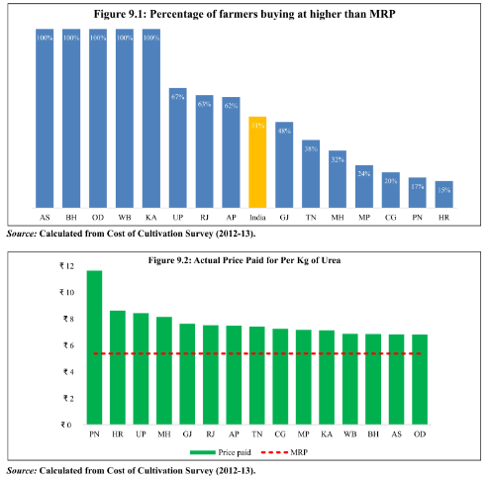
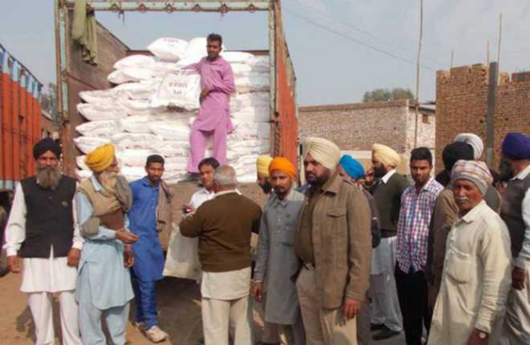
Urea Black market prices
Farmers “Gherao” of Urea trucks In Punjab
Private sellers create artificial shortage / divert
Force farmers to pay more / buy addl. things

Slide 36
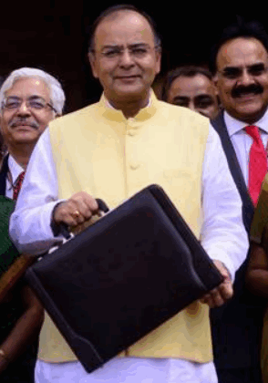
Leakage-2B: Diversion to non-agri purpose
Agri.
Nitrogen
Non-Agri
chemical industry, explosives, automobile systems, laboratories, medical uses, flavor enhancing additive in cigarettes
Soln: Neem Coating
Neem coating: reduces N-Loss from Soil = <quantity needed
1 product
1 use principal violated = diversion

Slide 37

Urea import are canalised
input
Only 3 public sector firms allowed to import
Government will tell them how much to import, Where to deliver
But time lag in info = farmers will buy black market before season is gone.
Soln: allow more import-companies;
JV done with Oman (energy prices low = cheaper production) explore more nations like this.

Slide 38
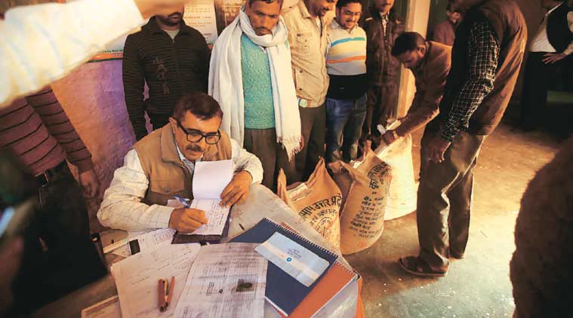
Urea Subsidy: Use BAPU or JAM, says Survey
biometrically authentication physical uptake (BAPU)
Like cylinder- cap on no. of bags. ~2 bags need per acre of wheat
Rural Financial inclusion is low

Slide 39
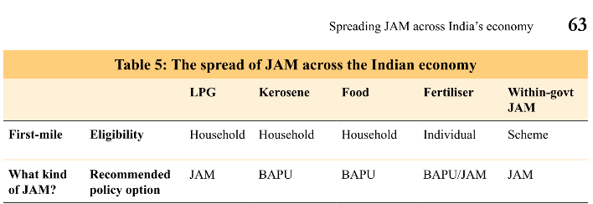

Urea
Pilot project for Fertilizer DBT in few districts.
Budget 2016
Either way,
less leakage = more money for gram Sadak, irrigation schemes

Slide 40
(Produce) More from Less (fertilizer)
Nutrient
N
Ideal
India
Source
Urea
4
8
Diammonium Phosphate (DAP)
Muriate of Potash (MOP)
K
P
2
1
3
1
Notes:
3 basic types of fertiliser used—NPK idea ratio : 4:2:1- overuse in both India and China.
DAP-MOP under NBS- Per kg subsidies on DAP and MOP fertiliser are hence fixed—they do not vary with market prices.
Imports of DAP and MOP are also not controlled.
In many ways, urea dominates the sector. Of all the fertilisers, it is the most produced (86 per cent), the most consumed (74 per cent share), and the most imported (52 per cent).

Slide 41
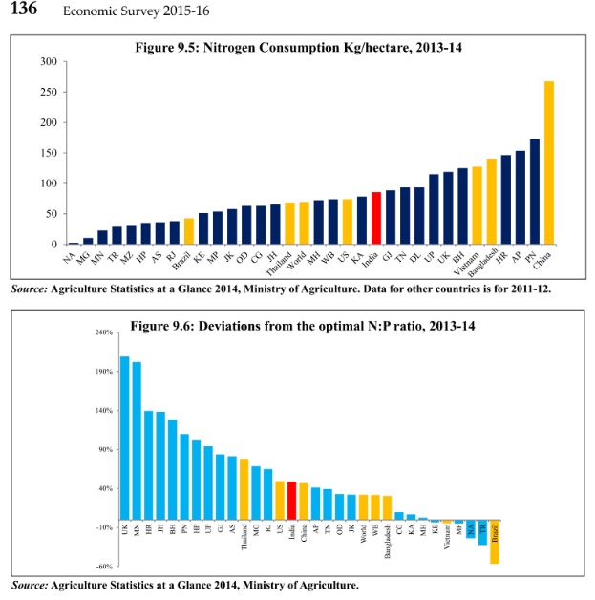

Urea Overuse

Slide 42
Soil Healthcard: 12 parameters
Micro Nutrients
Physical Para
Macro
Electrical conductivity
PH
Organic Carbon
N- Nitrogen
P- Phosphorus
K- Potash
Secondary nutrient
Sulfur
Zinc, Iron
Copper, Manganese
Boron

Slide 43
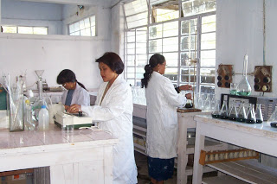
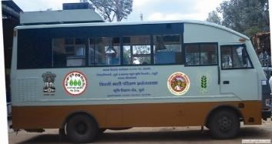
Implementation: testing every three years
Union- Agri Department- “core scheme”
Rs.190/- for testing to card delivery
Outsourcing agency
State
Implement
Who’ll test samples?
State’s own staff/Department
Science /agri. College
ICAR, KVK
MRIDA-Parikshak Mobile Lab

Slide 44
Yearbook
Through soil health card, we can directly find?
Acidity or alkalinity of the soil
Micro & Macro nutrients in the soil
Pesticide residue in the soil
Choices:
A): Only 1 and 2; B): Only 2 and 3;
C): Only 1 and 3; D): All of them

Slide 45
Pillar #4: Sectors of Economy ► Agriculture
Seeds, Irrigation, Fertilizer, Pesticides
Diversify
Credit, Insurance, Marketing
Husbandry
More from Less
$$
organic, pulses

Slide 46
(Produce) More from Less (Pesticides)
25% crop lost by weeds, pests, diseases and rodents.
Per ht. pesticide consumption far lower than 1st world
But substandard or Improper use e.g. spray/ dissolve
Residues in food.
Need more biocontrol agents, bio-pesticides
Stat
Problem
Sol

Slide 47

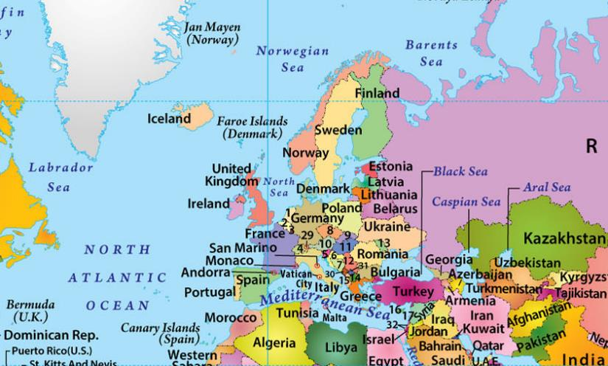
India: Endosulphan- “cost effective” pesticide
2001: Stockholm convention on persistent organic pollutants (POPs) Banned, but India sought 10 years extension
1998: Rotterdam convention, Pesticides intl.trade

Slide 48
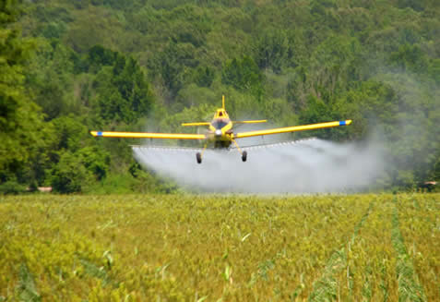
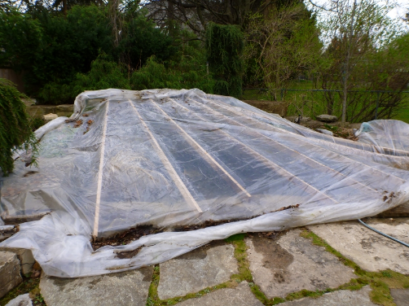
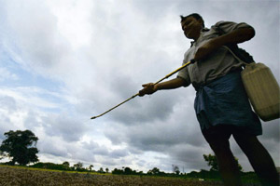
Improper usage of Endosulfan (Organic pesticide)
Aerial spraying
Ultra-low conc, product required
Water bodies must be covered during aerial spray to prevent contamination
Higher conc. Product meant for knapsack spraying.

Slide 49
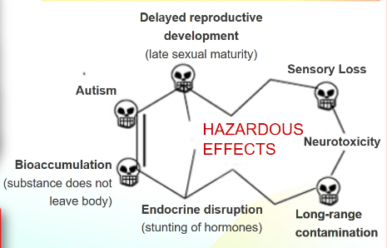
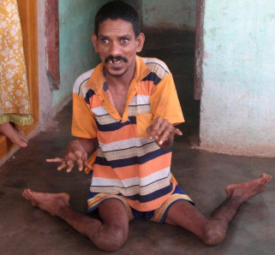
KASARGOD DISASTER, Kerala
80s-90s
Food, water, Mother’s milk
Aerial spraying on Cashew plantations
whiteflies, aphids, beetles, worm
Birth deformities- Stag horn limbs

Slide 50

NCERT Bio. Class12, Ch.10, Page 187 onwards
Biocontrol Agent
Ladybird beetle
Bacillus thuringiensis (bt)
Against
Aphids
Mosquitoes
Dragonfly
Larva- gut toxin
Trichoderma Fungus
Pathogens in roots
Baculo-virus | nucleo-poly-hedro-virus
Narrow spectrum; no harm to bird, fish, mammals
Biocontrol- don’t kill ALL, keep them under manageable level for the foodchain/foodweb
Notes:
A&R

Slide 51
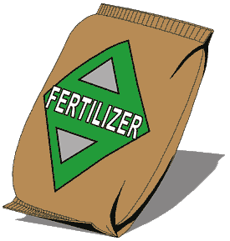
Bio fertilizers: NCERT Biology Class12, ch.10
Nitrogen: UREA
Bacteria @root: rhizobium
Cyanobacteria- autotrophic, @aquatic, terrestrial environment e.g. Anabaena, Nostoc, Oscillatoria. Good for Paddy fields
Phosphorus: DAP-Di-ammonium phosphate
Fungus: Mycorriza, Glomuz genus
Help in plant resistance against salinity & drought
Organic Matter
Blue green algae
Bacteria @soil: azo-spirill-um, azoto-bacter
Have symbiotic relation with plant
Chemical Fertilizer increase subsidy bill, soil contamination

Slide 52

NCERT Class12 Bio ch. 10

Slide 53

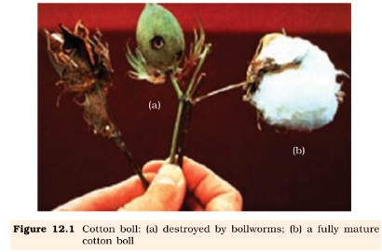
NCERT Class12 Biology ch. 12

Slide 54
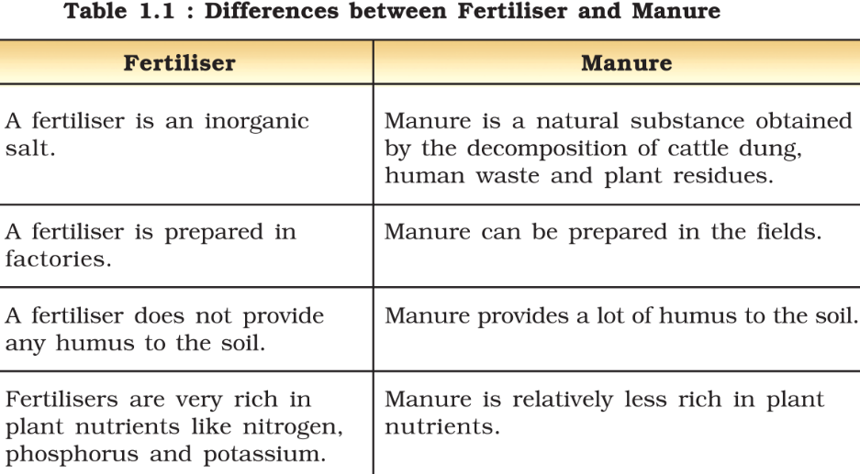

Slide 55
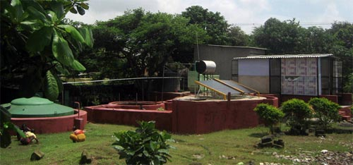
BARC contribution
YEARBOOK
Sesbania rostrate for small farmers: green manure crop, nitrogen fixation
Nisarga-Runa technology: biodegradable solid waste into useful manure and methane.
Notes:
helping to reduce fly ash emission from thermal boilers. The developed at BARC converts biodegradable solid waste into useful manure and methane.
The Nisarga-Runa technology developed at BARC converts biodegradable solid waste into useful manure and methane.
NISARGRUNA PROCESS
The waste resources which can be processed using Nisargruna Biogas plant include biodegradable kitchen waste, paper waste, green grass, leaf litter, animal remains in abattoirs, hospital waste, green plant waste, cow dung, crop residues, sugarcane, baggase, water hyacinth, etc.
The waste is first segregated carefully to remove non-biodegradable material and then homogenized to make a slurry. It is then processed in a sequential manner first by aerobic and then by anaerobic process. The products of the process are biogas consisting of methane, carbon dioxide and water vapor & weed free good quality manure. About 70% of Water can be recycled at the end of the process.
ADVANTAGES
Nisargruna Bio Gas Plant would serve many purposes such as:- 1 Environment friendly disposal of waste, which is the need of the hour. 2 Generation of fairly good amount of fuel biogas, which will definitely support the dwindling energy resources. The gas can be used for as fuel in the kitchen or for power generation. 3 Generation of high quality, weed free manure, which is an excellent soil conditioner. This is very important for replenishing organic carbon in the undernourished soil after years of agriculture.

Slide 56
Manure
10 lakh compost pits for organic manure
Budget 2016

Slide 57
Pillar #4: Sectors of Economy ► Agriculture
Seeds, Irrigation, Fertilizer, Pesticides
Diversify
Credit, Insurance, Marketing
Husbandry
More from Less
$$
organic, pulses

Slide 58
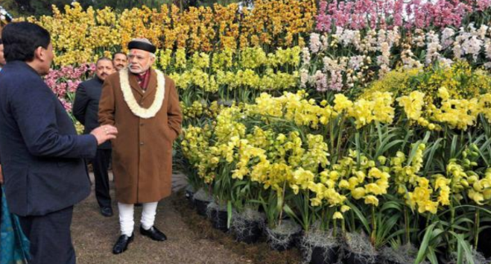
Organic Farming

Slide 59
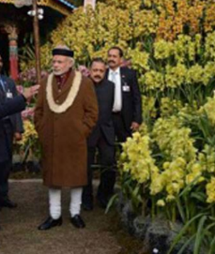
Paramparagat Krishi Vikas yojana
Scheme
Organic farming = w/o chemicals, pesticides
Rs.20k/acre to each farmer from seed to marketing
Sikkim: “Land of flowers”, “Fully Organic state of India” –
USA’s California, Wisconsin also pursue similar marketing
Notes:
50 acre cluster
Fertilizer Subsidy bill = 10% GDP [2nd largest after food]
low organic carbon (67% of soil)
Deficiency in micro nutrients like boron, zinc, copper and iron
need vermicomposting, organic manure

Slide 60
Organic farming
bring 5 lakh acres under organic farming over a three year period.
Emphasis on value chain from North East.
Budget 2016
Notes:
vol1-04-Agriculture_ More from Less
vol1-09-The Fertiliser Sector
vol2-05-Prices, Agriculture and Food Management

Slide 61
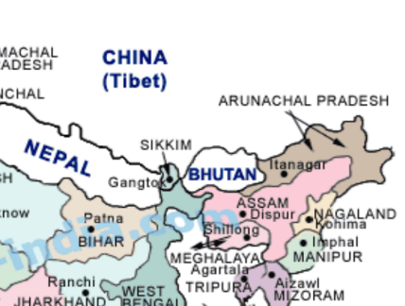
Geography
State sharing border with Bhutan, Nepal, China?
Sikkim
Arunanchal
Manipur
None of above.

Slide 62
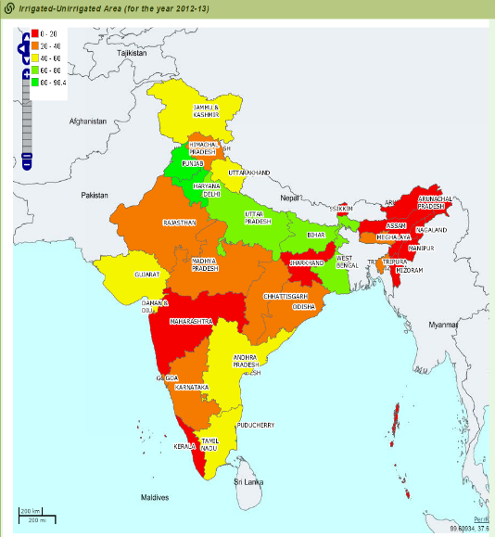
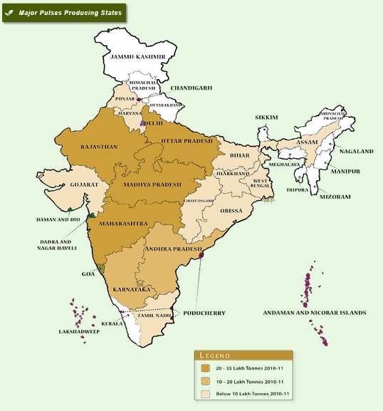
Vegetarian juntaa = Pulses4Protein but…
US Economist Michael Kremer- promise to buy HIV-vaccine
R&D Less; Mostly on un-irrigated area
Land diversion to industrial/commercial purpose
MSP:23 crop but only rice, wheat, cotton procured
MSP should reflect Social cost
Notes:
Vegetarian junta = pulses are protein source.
Irrigated water= sugarcane / wheat.
Pulse R&D less: Economist Michael Kremer- prize-promise to buy vaccine for HIV- similar incetive here needed.
MSP regime not favorable- as such 23 crops covered, but procurement only for rice,wheat, cotton.
Survey: MSP should reflect social returns e.g. growing wheat, sugarcane or paddy, taking account of the negative externalities from using chemical fertiliser (soil depletion and health), water (falling water tables), and from burning crops (adverse health consequences).

Slide 63
Survey: MSP should reflect social cost
Sugarcane, rice, wheat: negative externality
Pulses: positive externality
Need less Ferti.
chemical fertilizer (soil depletion and health)
water (falling water tables),
burning crops (adverse health consequences).
Deep-extensive root system =Keeps soil porous, aerated
Nitro fixing
Less water
Or, instead of MSP, floor price system – if sold below floor price, then Government will DBT 50% of difference. = less subsidy burden, more WTO compliance.

Slide 64
MSP who declares and for what?
Kharif
Paddy
Jowar
Bajra
Maize
Ragi
Tur (Arhar)
Moong
Urad
Groundnut-in-shell
Soyabean: Black/ Yellow
Sunflower Seed
Sesamum
Nigerseed
Cotton- medium & long staple
Rabi
Wheat
Barley
Gram
Masur (Lentil)
Rapeseed/ Mustard
Safflower / Kusum
Other
Copra
Coconut-dehusked
Jute
Sugarcane- FRP
CACP recommends
Commission for Agricultural Costs and Prices (CACP)
CCE approves
Cabinet Committee on Economic Affairs, by PM

Slide 65
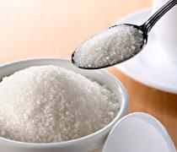
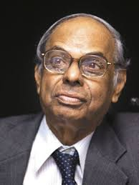
Sugar arrears
FRP | SAP
Fair & remunerative prices | State administered prices
Union fixes | State fixes
 | Higher than FRP for vote bank. Mill owners’ arrears.
C.Rangarajan panel said abolish.
SEFESU-2014: interest free loan by union to mill owners

Slide 66


Slide 67

Crop Diversification in original green rev. states
Promotion of
Pulse, Oilseed, Maize
Agro forestry
Water table recharge
W.UP

Slide 68

Pillar #4: Sectors of Economy ► Agriculture
Seeds, Irrigation, Fertilizer, Pesticides
Diversify
Credit, Insurance, Marketing
Husbandry
More from Less
$$
organic, pulses

Slide 69

PM Fasal Bima Yojana 2016, Jan
Scheme
Gone National Agricultural Insurance Scheme and Modified NAIS
Against natural calamities
Remote sensing, smart phone, DBT for payment; Gujarat: only e-portal
Kharif premium: 2% (of the total premium)
Rabi: 1.5%
Horticulture/Commercial: 5%

Slide 70

PMFBY ► Agri Min ►
1
Sarkaari Agriculture Insurance Company of India Limited (AIC)
4
Sarkari General Insurance cos. (L2/P12)
11
Private insurance cos.
Under consideration

Slide 71

Insurance related
Definition | 2001 | 2014
Insurance penetration: premium volume as a ratio of GDP | 2.71 | 3.3 (Global: 3.4%)
Insurance density: ratio of premium to population (per capita premium) | $11.5 | $55 (Global: >290$)
Increased with financial inclusion
But as such India sucks on world stds.

Slide 72



Agri-finance
KCC-1998
2006
Public & private scheduled commercial banks, RRBs, Cooperative banks
7% upto Rs.3 lakh
-2% : all
-1% : regular payers
= 4% Effective interest
Extension
KCC: +3 months
Natural calamity: 1 year
NWR: 6 months
What did Deepak Mohanti Committee say?
BES161-P9

Slide 73

Agri-credit
inputs
NITI Ayog Expert panel recommends model law to formalize land-leasing so informal tenants can get bank loan, insurance and disaster relief.
Duration: Short term >> Long term credit (=machinery, land upgrade less); NABARD should explore
Notes:
Government gave long term rural credit fund to NABARD.
40% credit coming from informal sources

Slide 74

Farm mechanization: why and how?
Why?
Less Time, cost, labour, wastage
How?
Ergonomically designed for Female to reduce drudgery, safety
Region specific
“Ola-Tractor” rental (among large farmers hardly 38% own tractor +land fragmentation) = e-tech. in the aid of farmer for GS3 (but already asked in 2015)
More uniform sowing, harvesting, processing
Urbanization, make in India, MNREGA= labour shortage
<50% mechanized farming in India

Slide 75
Pillar #4: Sectors of Economy ► Agriculture
Seeds, Irrigation, Fertilizer, Pesticides
Diversify
Credit, Insurance, Marketing
Husbandry
More from Less
$$
organic, pulses

Slide 76


NAM: Only 12 states reformed APMC so far to implement It
E-Auction, Price discovery
Information Asymmetry
Farmer: Single market fee @Wholesale
Mandi charges, Agent Commission
Agriculture Tech Infrastructure Fund (ATIF) to run this site http://www.enam.gov.in
Trader: Single license valid across state.

Slide 77

NAM: Criticism
$$ , information
NAM Portal
Physical Goods moved through
Mandi
Inter-state
Intra-state
Only 12 states reformed so far…
most farmers don't bring produce themselves to Mandi, they sell it to Baniya/Arhatiya (middleman/aggregator) to settle loans.
Soln: KCC-JAM, farmers cooperatives, Ola-truck/tempo.

Slide 78

AGRI MIN
500 Cr.
Budget 2015
To combat food inflation
Union gives interest free advance
State procurement agencies to buy from farmers
Started with onion & Potato

Slide 79

Who is implementing these things?
Dept.Agri
Small Farmers’ Agri-Business Consortium (SFAC)
NAM Portal
PSF Fund

Slide 80
Core scheme: Krishonnati Yojana| 60-40 | 90-10
Natl. Food security Mission
Fruits, veggies, tubers, Bamboo
Rice, wheat, pulses
NFSM-Commercial
Cotton, jute, sugarcane
Horticulture Mission
Oilseed, Oilpalm Mission
Sustainable agriculture
Soil Healthcard
Agri-Cooperation, Marketing
Agro Forestry
Agri Census

Slide 81

ICAR
Extension
Indian council of agri. Research - Autonomous body
Farmer first (Innovation, research)
Student Ready (entrepreneurship)
ARYA: Attracting and retaining youth in agri.
Mera Gaon-Mera Gaurav: field visit by experts

Slide 82
Pillar #4: Sectors of Economy ► Agriculture
Seeds, Irrigation, Fertilizer, Pesticides
Diversify
Credit, Insurance, Marketin,Extension
Husbandry
More from Less
$$
organic, pulses
Ranking
Budget’16

Slide 83

Livestock census: since 1919, latest 2012
Per capita Availability of
Milk (>than world), Egg:
Registrar general of India
Cattle
Poultry
Buffaloes
Goat
Sheep
Pigs
INCREASING Order
Small ruminants
BPL Backyard
2013: Indigenous cattle conversation
Gir, sahiwal, kankrej etc.
Milk yield less but quality more;
disease-drought proof
Hissar, Centre Breeding Farm
Threatened Breeds conservation
Arunanchal Pradesh – Yak, Pony
Notes:
The per capita availability of milk
in India has increased from 176 grams per
day in 1990-91 to 322 grams per day by
2014-15 (Figure 5.22). It is more than the
world average of 294 grams per day during
2013.

Slide 84

Fish production: 1st China, 2nd India
INCREASING Order
Cold fresh water
Warm Fresh water
Sea
Estuaries

Slide 85
Animal husbandary
Pashudhan Sanjivani: Animal wellness
Nakul Swasthya Patra: health card for animals
‘E-Pashudhan Haat’: online portal for Breeder to farmer connect
National Genomic Centre for Indigenous breeds.
Total Rs. 850 cr.
Budget 2016

Slide 86

UPSC CAPF-2016 [BES164]
Khadi village industries commission aims to
providing employment in rural areas;
producing saleable articles;
creating self-reliance amongst people and building up a strong rural community spirit.
Ans A)1,2,3 B) 1 and 2 C) 2,3 d) 1, 3
IYB 2016 Ch.19 industries, Page 557 all of above.

Slide 87

UPSC CAPF-2016 [BES164]/Geo.
1)Muga, 2)Eri, 3)Mulberry, 4)Tasar: arrange them in decreasing order of production
3241
3421
2413
2143
IYB 2016 Ch.19 industries, Page 555
Notes:
Wanted to confuse between A and B!

Slide 88

GS3 Mains
M-Kisan, E-tech in aid of farmers: ML4/P2
Nat.Miss. Agri. Ext.Tech: 1) Seed, 2) mechanization 3) pest/disease 3) extension
Agri clinic- local entrepreneur
Kisan Call Centre (1800-180-1551)
DD Kisan Channel
Bovine breeding, Livestock mission
Dairy- development entrepreneurship
Food processing- dairy, meat

Slide 89
Pillar #4: Sectors of Economy ► Agriculture
Seeds, Irrigation, Fertilizer, Pesticides
Diversify
Credit, Insurance, Marketin,Extension
Husbandry
More from Less
$$
organic, pulses
Ranking
Budget’16

Slide 90

Pillar #4 => Sectors of Economy => MFG
Types- employment
DPP-2016
Textile Shift
Startups
Regulatory Cholesterol

